Slide 1
The Daily Travel Trajectory Generation System For Urban Residents
2025/8/24 intelligence：Junyang Peng Hengyu Lyu

Slide 2

TOPIC
How can LLM-based agents contribute to refined urban management？

Slide 3
CONTENTS
01 Data Preparation
02 Agent Design
03 Results Evaluation
04 Application Scenarios

Slide 4
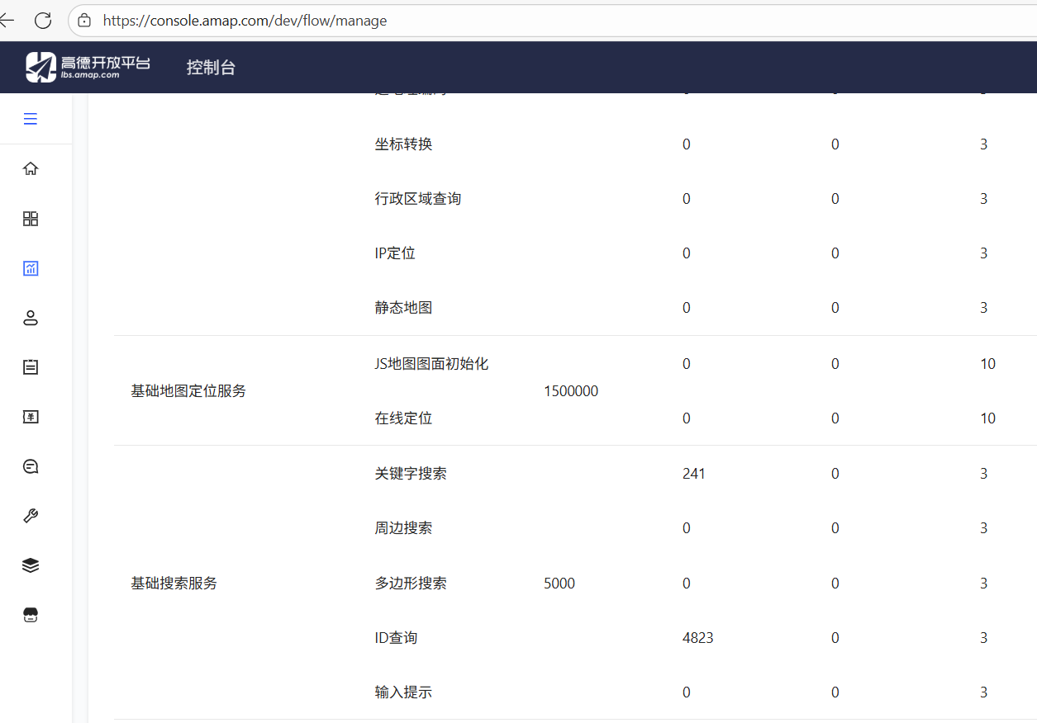
Data Preparation
01
To get POI data, we called the API of AutoNavi Maps to collect POIs by location category within the scope of Beijing.
1/13

Slide 5
Data Preparation
01
To get user data, we generated a five-dimensional weight table according to the real proportional data of the census, and generated 100 simulated users based on this weight.
The following are the sources of the real proportional data we used:
https://usa.ipums.org：中国 2020 年人口普查 1 % 微观数据（IPUMS International 2020 China 1 % sample）， https://tjj.beijing.gov.cn：《北京统计年鉴 2023》(Beijing Statistical Yearbook 2023)
Adventages:
highly consistent with the real situation
diverse and representative
2/13

Slide 6
Agent Design
02
Construct prompt words with information such as resident attributes and POI lists, and call the large language model. The large language model will generate personalized trajectories for each user and save them as individual JSON files.
The model we use: qwen-max-latest
Temperature: 0.3
Use asyncio to asynchronously handle the task of generating multiple residents' trajectories
Implement a local JSON caching mechanism
3/13

Slide 7
03
Results Evaluation
the consistency between the generated POI visit distribution and the actual distribution
the access distribution (KL)
the average moving radius
the consistency between the generated user activity range and the actual activity range
the consistency between the generated user travel behavior and the actual travel behavior
the average travel chain length
4/13

Slide 8
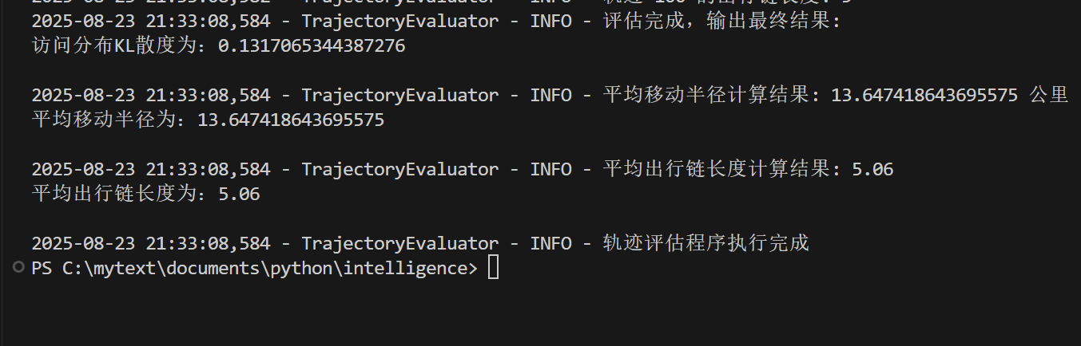



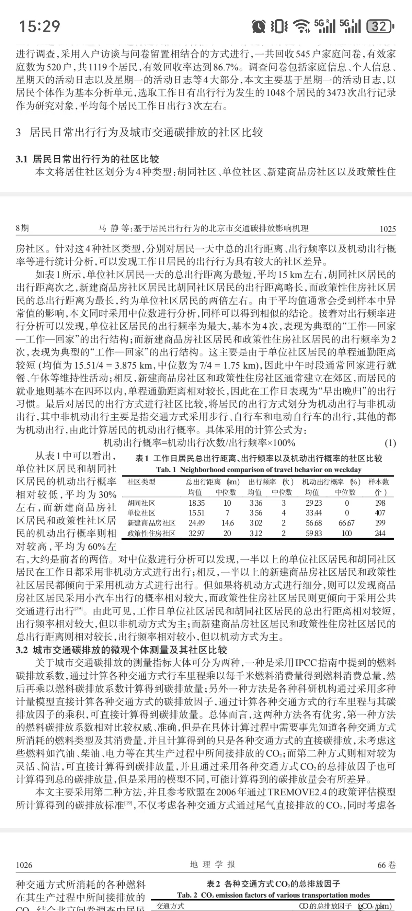

03
Results Evaluation
调研方法
data source:
https://ir.bjtu.edu.cn/handle/10364/9359《基于地铁刷卡的北京居⺠出⾏时空特征研究》
《基于居⺠出⾏⾏为的北京市交通碳排放影响机理》⻢静，柴彦威，刘志林- 地理学报, 2011
5/13

Slide 9
04
urban planning
business operations
public safety
evaluate the impact of newly built infrastructure
evaluate the impact of a new store on residents' travel patterns and surrounding POIs
predict the transmission path of diseases and formulate prevention and control strategies
城市规划
商业决策
公共安全
6/13

Slide 10
The Daily Travel Trajectory Generation System For Urban Residents
Welcome to criticize and offer corrections！

